Slide 1
Applied Data Science
Capstone Project – Health Care

Slide 2

FINAL PRESENTATION FOR SUBMISSION
“PREDICTING THE MORTALITY CAUSED BY HEART FAILURE USING MACHINE LEARNING MODELS”
Prepared by : ARUN RAMAMURTHY
Date : 15 - May 2023
15 – May 2023, Arun Ramamurthy

Slide 3
Organizational Background
Organizational Background:
Ram Health care is a reputed company, established in 1981 in the field of Bio-Medical instrument manufacturing segment. They have several medical instrument including Thermometer, Blood pressure monitoring device, Endoscopes, Ventilator etc.
As their business expansion, they planned to develop a medical application. This Application (App) can be used by various individuals to predict the death caused by Cardio-Vascular diseases.
This prediction is purely based on the several input factors entered by individuals who are interested to use this App.
Some of the highlights of this application is:
Individuals can enter input data (which shall be explained in the upcoming slides) such as Blood pressure, Diabetes condition of the individuals, etc.
The application software will analyse the data using in-built Python software and Machine Learning algorithm for prediction
The purpose of this App is to predict the chances of death caused due to Cardio-vascular disease based on the individual health related input data.
This Application is named as “RAM - Cardiac Risk Calculator”
15 – May 2023, Arun Ramamurthy
3 / 47

Slide 4

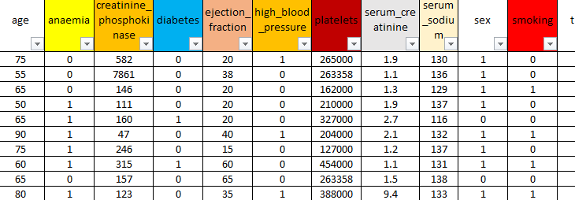
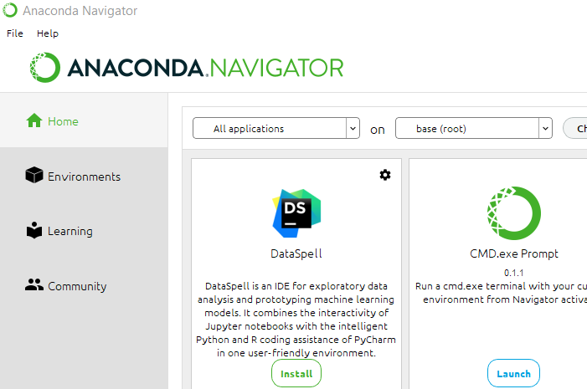

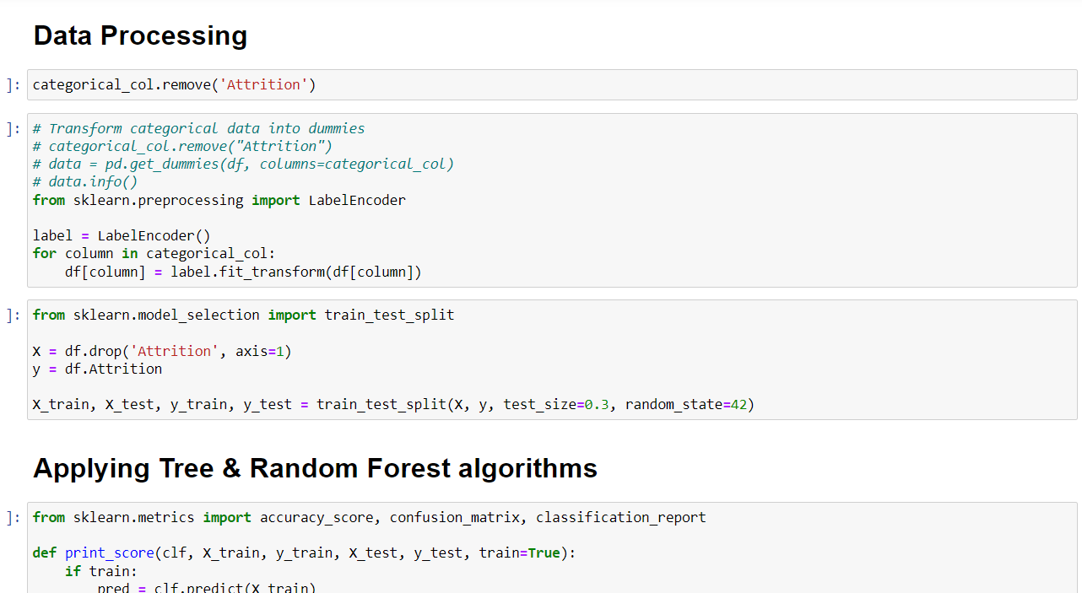
Resource and software requirement for this project
Resource and software:
In order to develop this Application software, they handed over project to In-house development team and the team listed out the requirement specification as mentioned below.
Software engineer with knowledge of Python programming and ML algorithms
Valid dataset which defines which are the inputs to consider for predicting mortality caused by Cardio-vascular disease
Anaconda Navigator software which is available for free download from Google
Python programming environment –which is available in Jupyter notebook
Jupyter notebook, which is embedded within Anaconda navigator
Further slides will take you through Dataset and software details used in this project to execute the project
“RAM - Cardiac Risk Calculator”
15 – May 2023, Arun Ramamurthy
4 / 47

Slide 5



Steps need to follow to prepare a model in order to detect mortality caused by cardiovascular disease
4.2 Unsupervised or Reinforcement Learning
5. Regression
1. Get Data from CSV file
NO
NO
Output is Discrete (True / False)?
7. Train the model with Training data (80 %) & suitable ML algorithms. Example: (Random Forest, KNN, Decision tree, etc..)
Data is Historical/labeled?
4.1 Supervised Learning
6. Classification
3.1 Train Data (80 %)
2. EDA (Exploratory data analysis)
3. Split Data
YES
YES
3.2 Test Data (20 %)
8. Test Model with Test data (20%)
Accuracy, Precision, confusion matrix, f1 score, ROC curve
Further section of this document will explain the meaning of each box header in relation to its number.
9.1 Classification
10. Ensemble Learning (Optional)
9. Evaluate model performance
9.2 Regression
R-Square, RMSE, MSE
15 – May 2023, Arun Ramamurthy
5 / 47

Slide 6
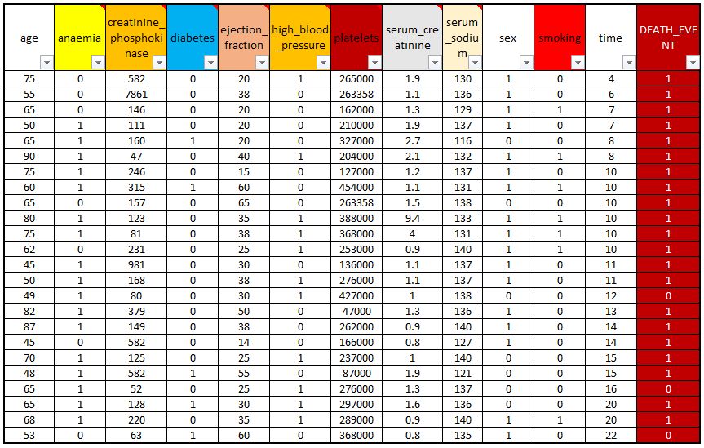
1. Get Data from CSV
In this project, as a first step we need to get the given data from Excel into python project for further analyzation.
As a common practice, this is done by importing panda's library.
Function used for this is pd.read_csv(“./Data/….filename…. .csv”)
Additional information about dataset:
As shown in previous slide, we have several input parameters.
Output prediction is “Death Event” as mentioned in the last column
Purpose of this machine learning algorithm is to predict the “Death event” based on all given input parameters
15 – May 2023, Arun Ramamurthy
6 / 47

Slide 7
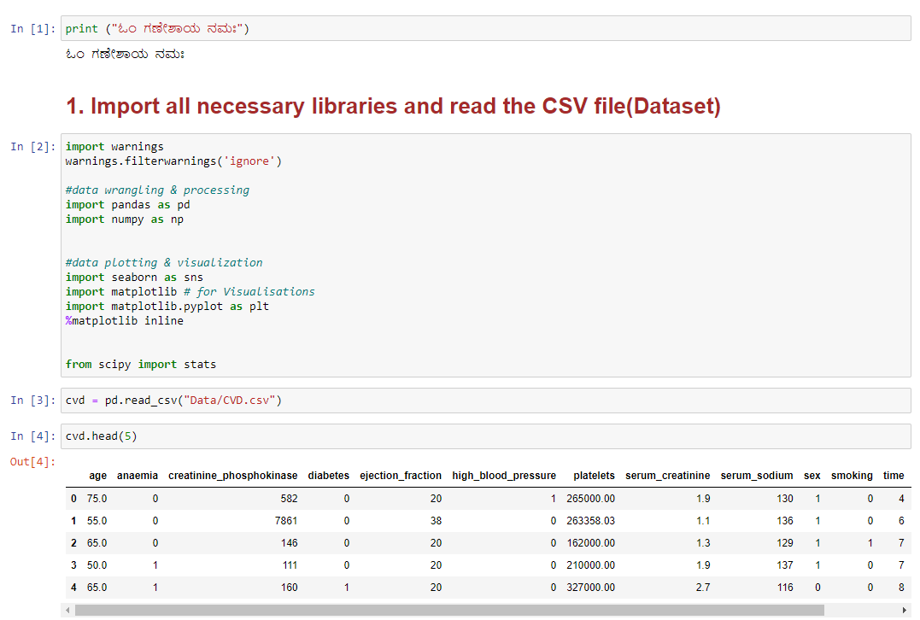
1.1 – Get data from CSV file + Import all required libraries
In this project, already data is provided in the CSV format. We need to get this data in to our Python environment so that, we can start working with this.
Following methods are used to complete this task.
Import necessary libraries in Python code. (Panda's library is the one which help us to get the Data form CSV file)
Here, data frame name is cvd
Read the Header of top 5 lines to get a quick look into data and its contents.
The Python code to do this job is enclosed in this slide.
Remaining libraries are imported for other purpose, which shall be explained in next sections
15 – May 2023, Arun Ramamurthy
7 / 47

Slide 8
2. EDA (Exploratory Data Analysis)
Exploratory Data Analysis
EDA involves various process related to data.
1. Collect the data to get application usage
2. Make sure, we have all relevant data and no null values
3. Measure the mean/median of data set
4. Measure the data variance and deviation
5. Check for right or left skewness of data
6. Plot various charts of data like Histogram, boxplot, bar plot, etc.
To conclude this is vary basic step and the output data from this process helps us to predict better results
15 – May 2023, Arun Ramamurthy
8 / 47

Slide 9
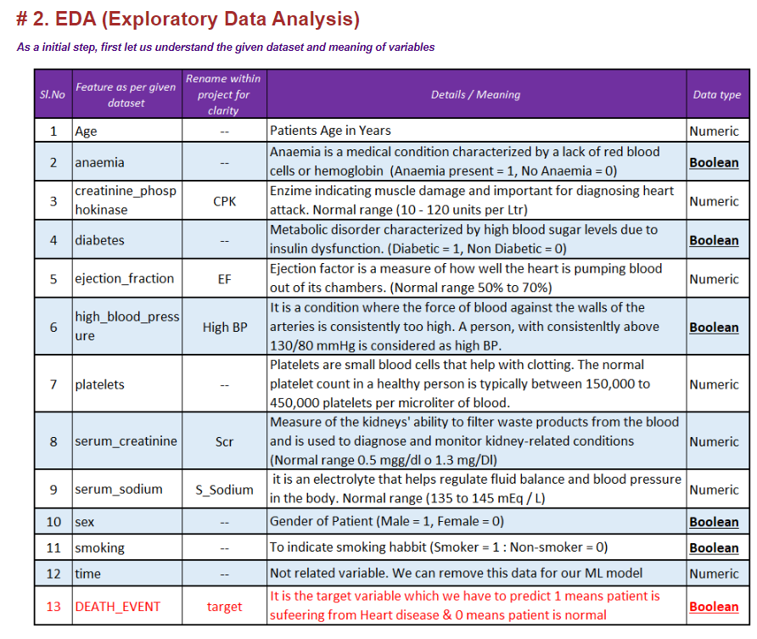

(EDA) 2.1 – Gain knowledge about the dataset
- As per WHO statistics, it has been estimated that 27% of the deaths in India are caused by Heart disease.
https://www.who.int/india/health-topics/cardiovascular-diseases
One-Third of the global deaths are due to Heart disease.
This situation is same in other developed countries (US/ Europe) as well.
Around 17.9 million people die due to Cardiovascular disease (CVD) every year worldwide.
15 – May 2023, Arun Ramamurthy
9 / 47

Slide 10
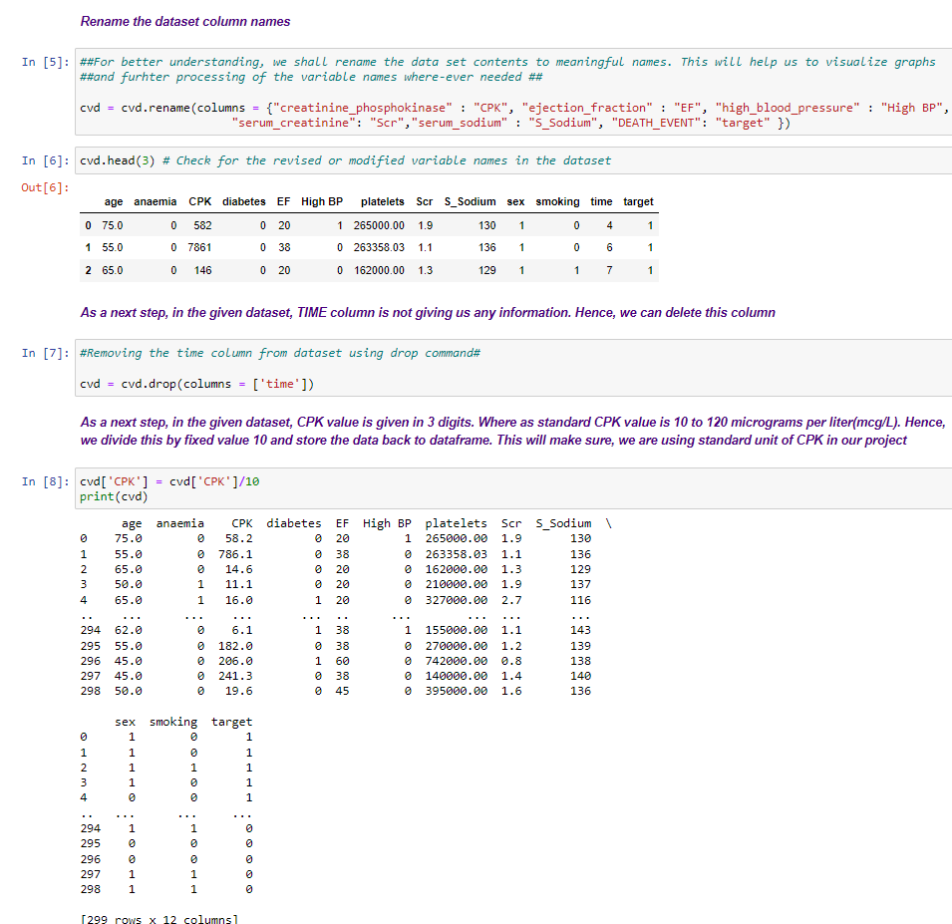
(EDA) 2.2 – Rename column names + remove column which is not necessary
15 – May 2023, Arun Ramamurthy
10 / 47

Slide 11
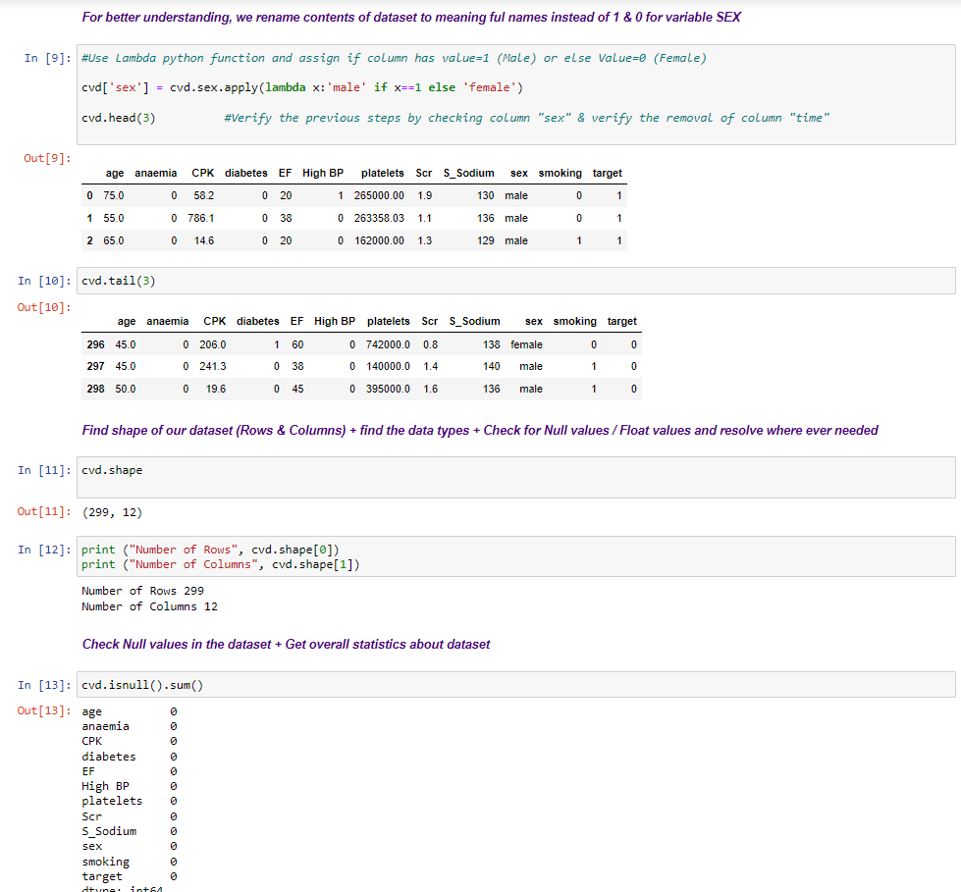
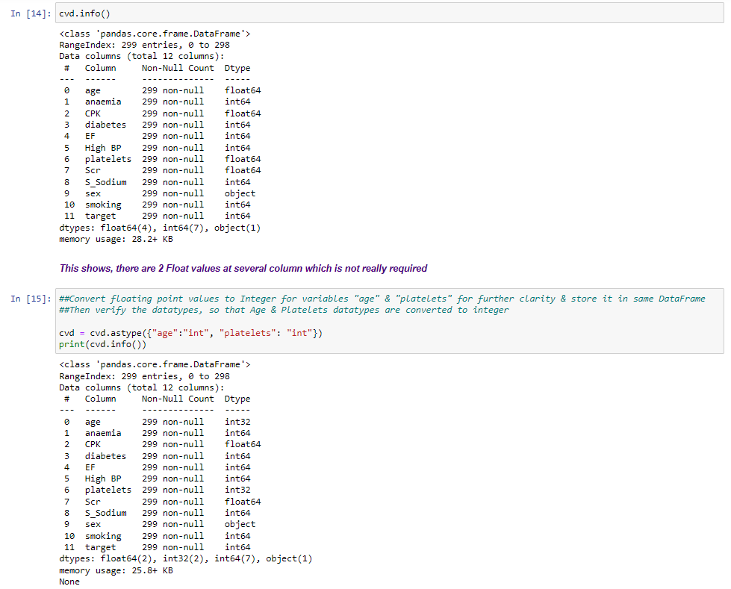
(EDA) 2.3 – Rename dataset + check header & tail of dataset + check null values + Check datatypes + convert data type if needed
15 – May 2023, Arun Ramamurthy
11 / 47

Slide 12
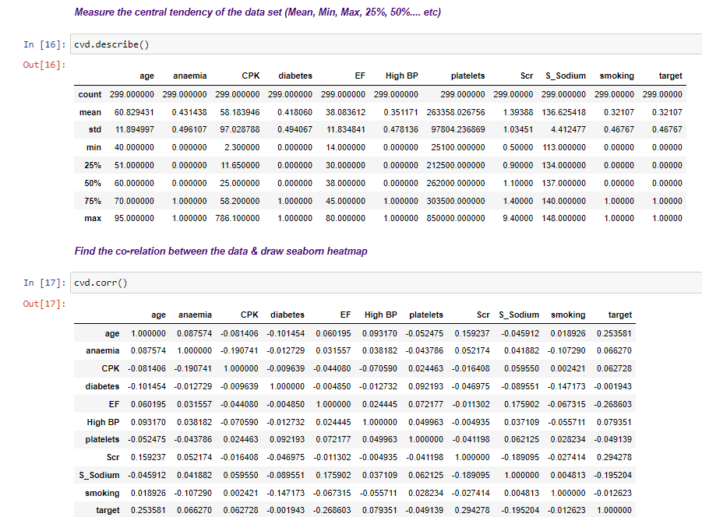
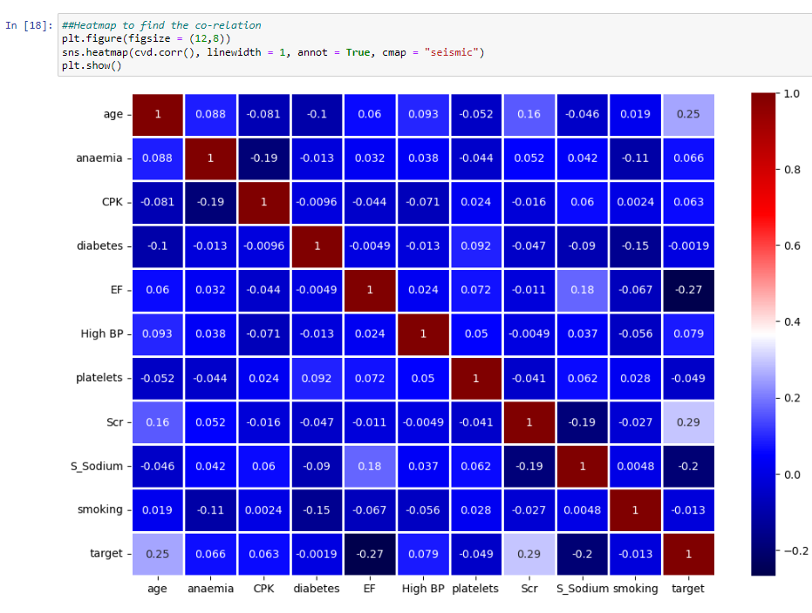
(EDA) 2.4 –check dataset tendency + Check for co-relation + Heatmap
Conclusion from Heatmap (co-relation) statistics:
In our dataset, “Age” & “SCR” are positively co-related with target variable(as they are showing very light colour)
“EF” & “S_Sodium” are negatively co-related with target variable (as they are showing very dark colour)
15 – May 2023, Arun Ramamurthy
12 / 47

Slide 13
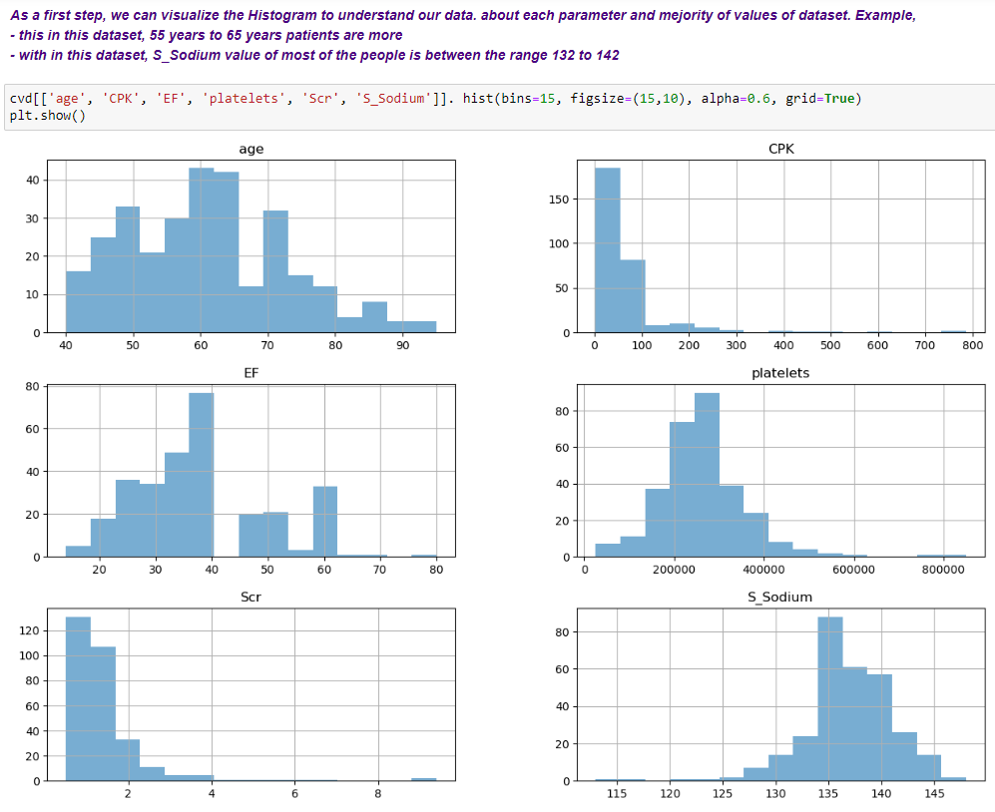
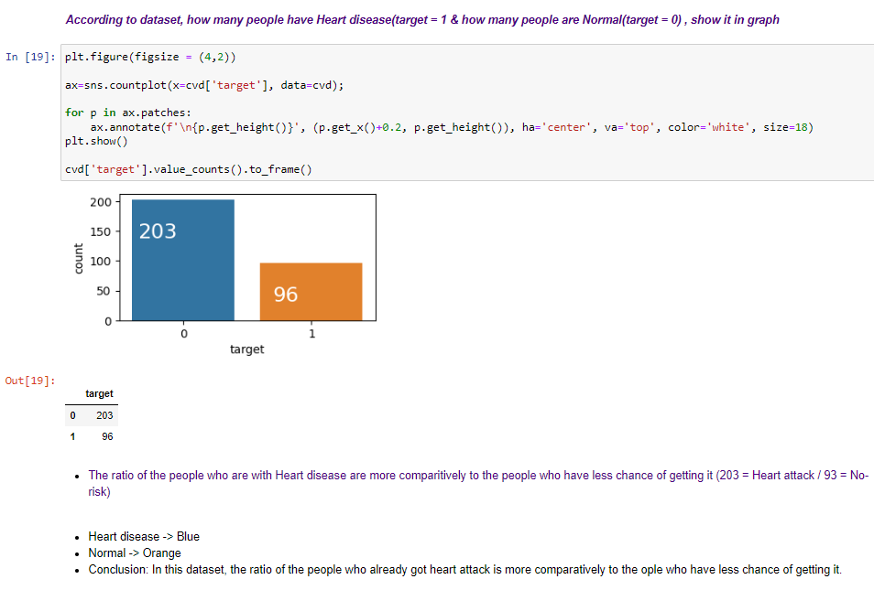
(EDA – Plots & Graphs) 2.5 – Plotting related to target variable + Histograms
15 – May 2023, Arun Ramamurthy
13 / 47

Slide 14
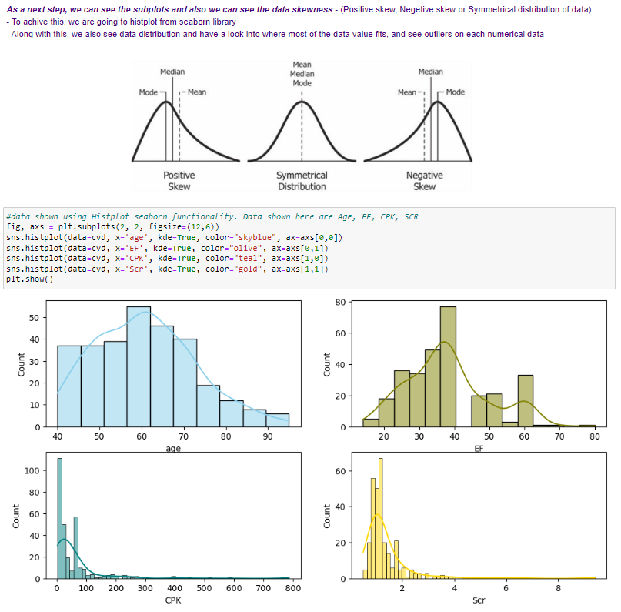
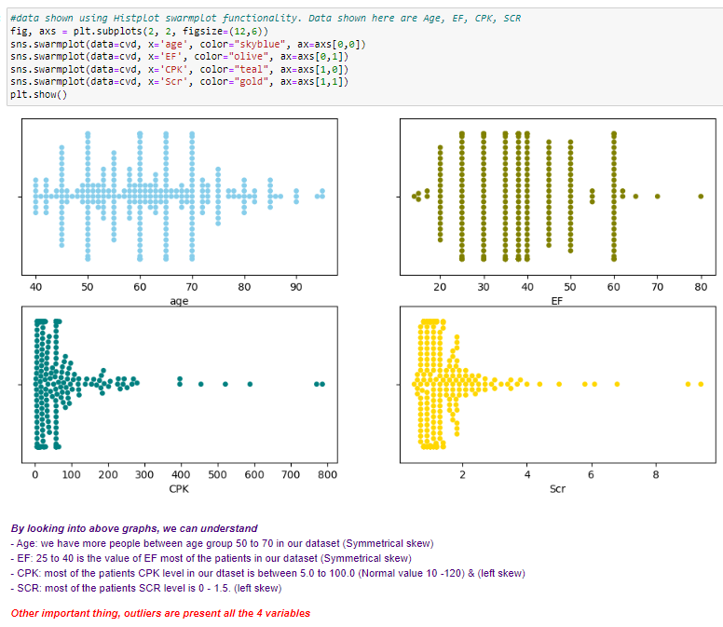
(EDA – Plots & Graphs) 2.6 – Check skewness of data using seaborn library “histplot” & “swarmplot”
15 – May 2023, Arun Ramamurthy
14 / 47

Slide 15
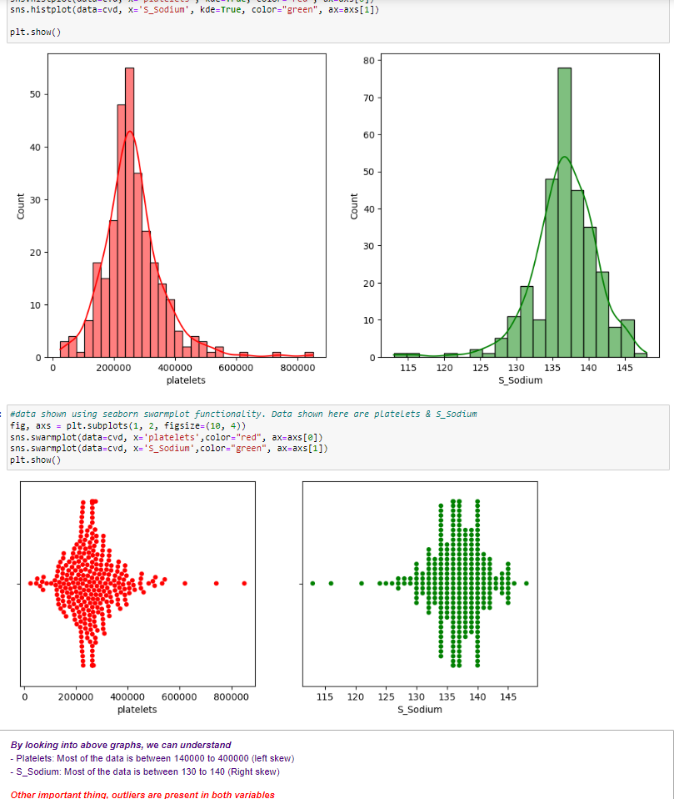
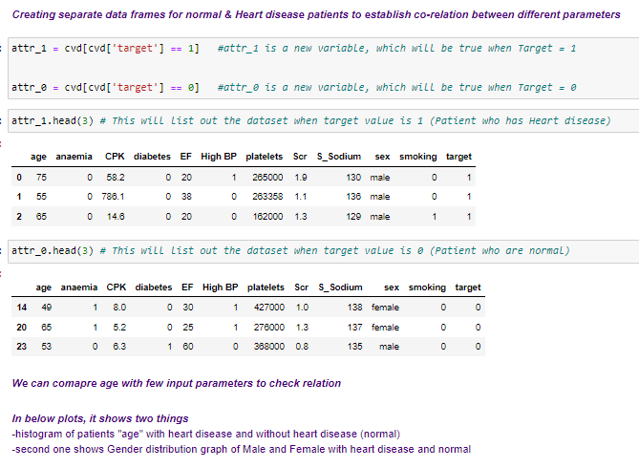
(EDA – Plots & Graphs) 2.7 – Check skewness of data using seaborn library “histplot” & “swarmplot” + Create separate data frames related to target
15 / 47

Slide 16
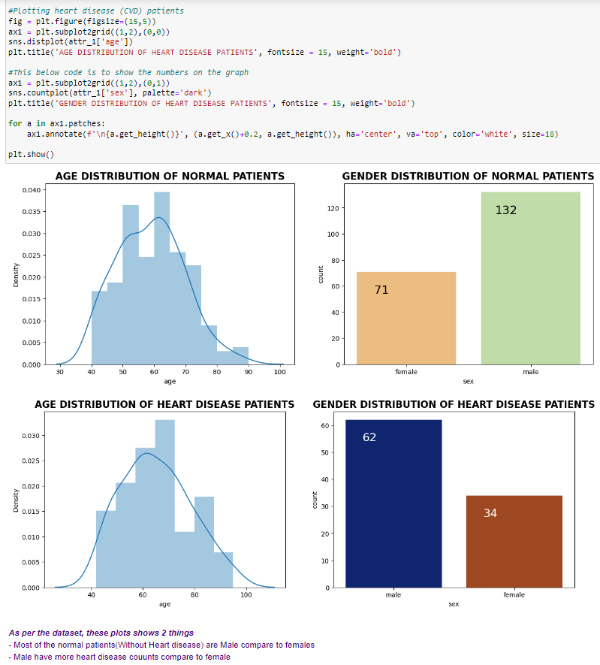
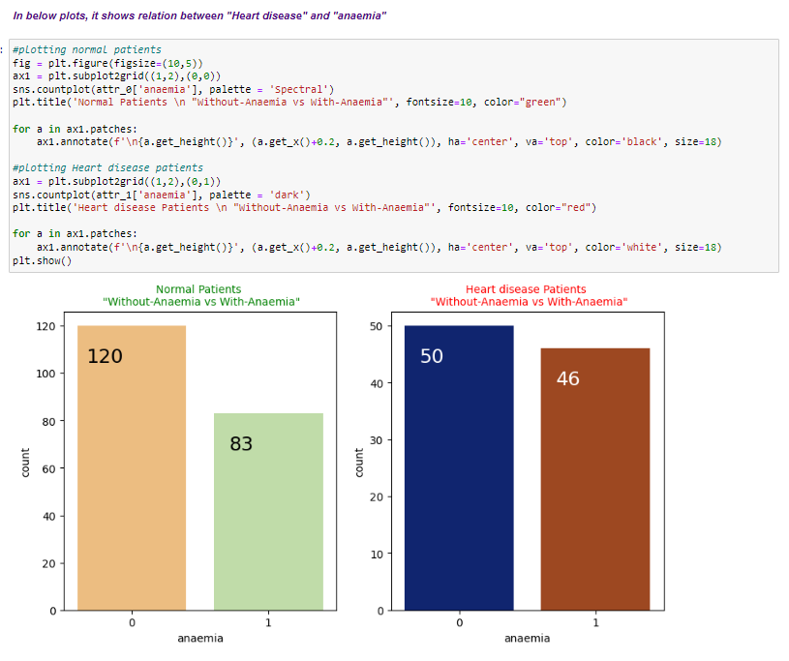
(EDA – Plots & Graphs) 2.8 – plotting all the input variables related to target (Heart disease)
16 / 47

Slide 17
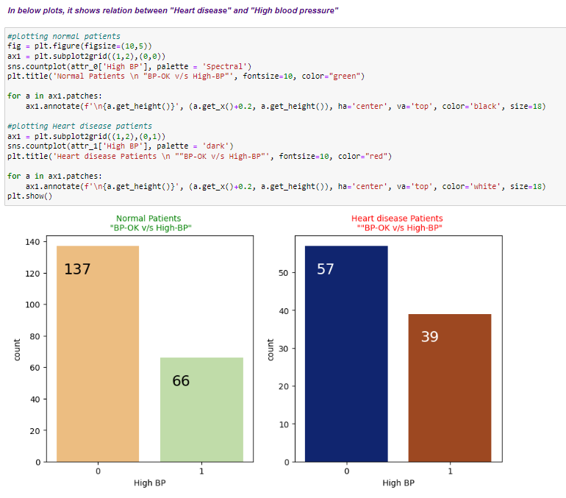
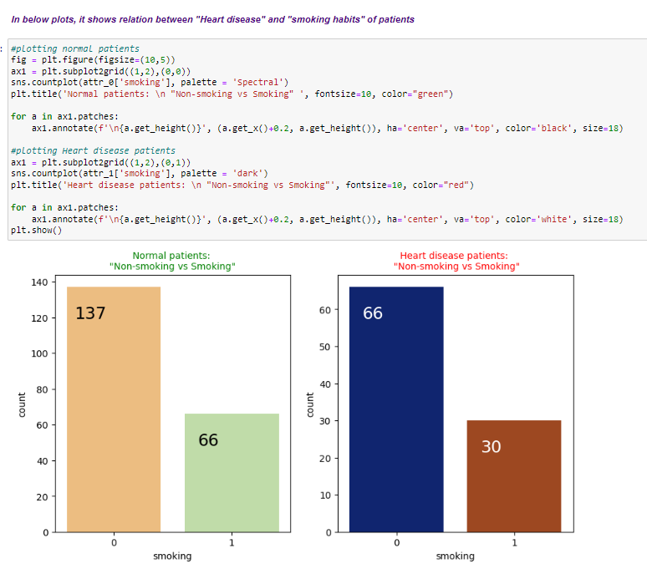
(EDA – Plots & Graphs) 2.9 – plotting all the input variables related to target (Heart disease)
15 – May 2023, Arun Ramamurthy
17 / 47

Slide 18
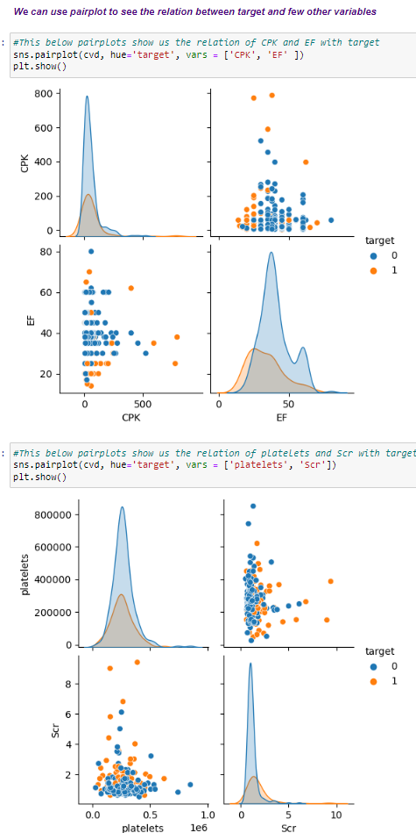
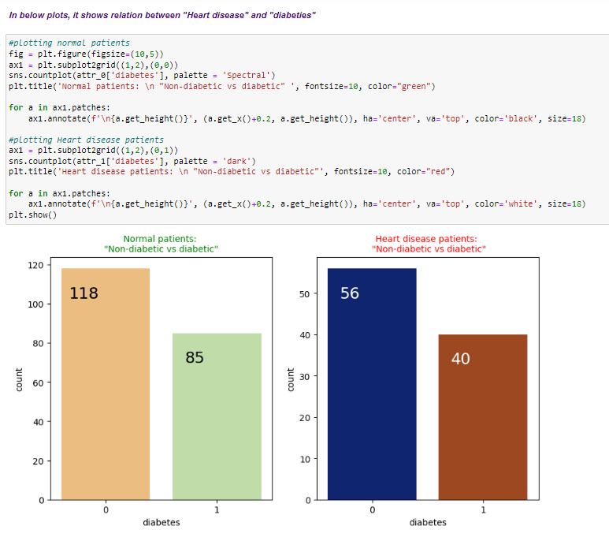
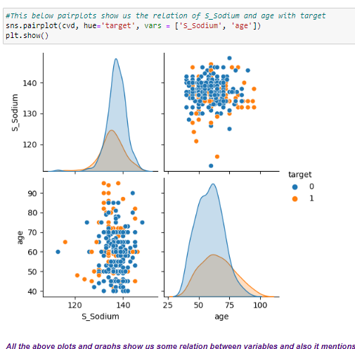
(EDA – Plots & Graphs) 2.10 – plotting all the input variables related to target (Heart disease)
15 – May 2023, Arun Ramamurthy
18 / 47

Slide 19
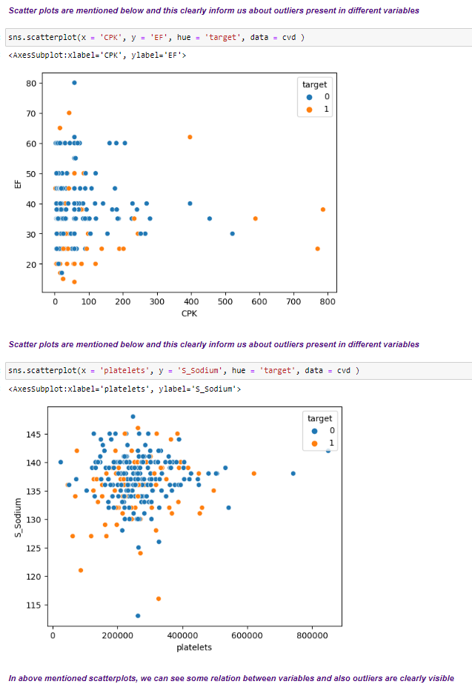
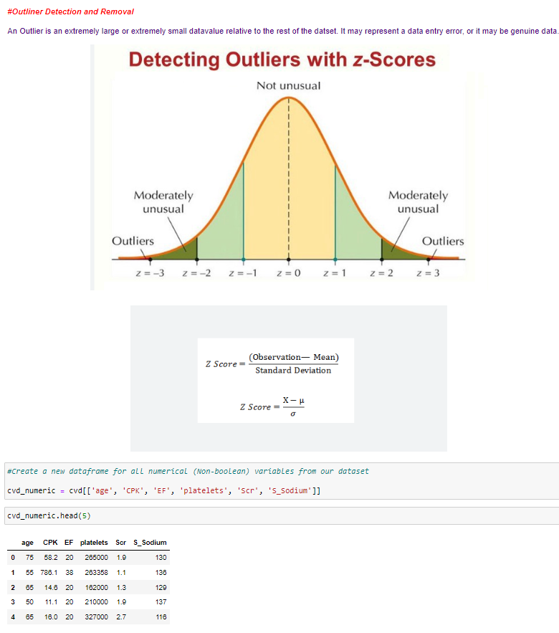
(EDA – Plots & Graphs) 2.11 – plotting all the input variables related to target (Heart disease) – Scatter plot from seaborn library + Outliers Z-Score
19 / 47

Slide 20
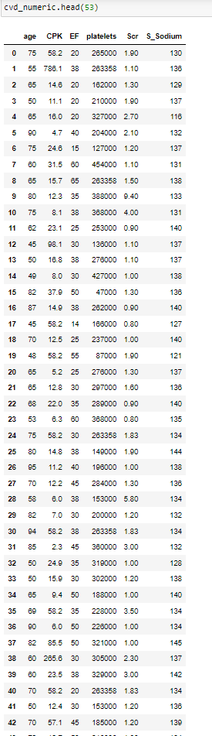
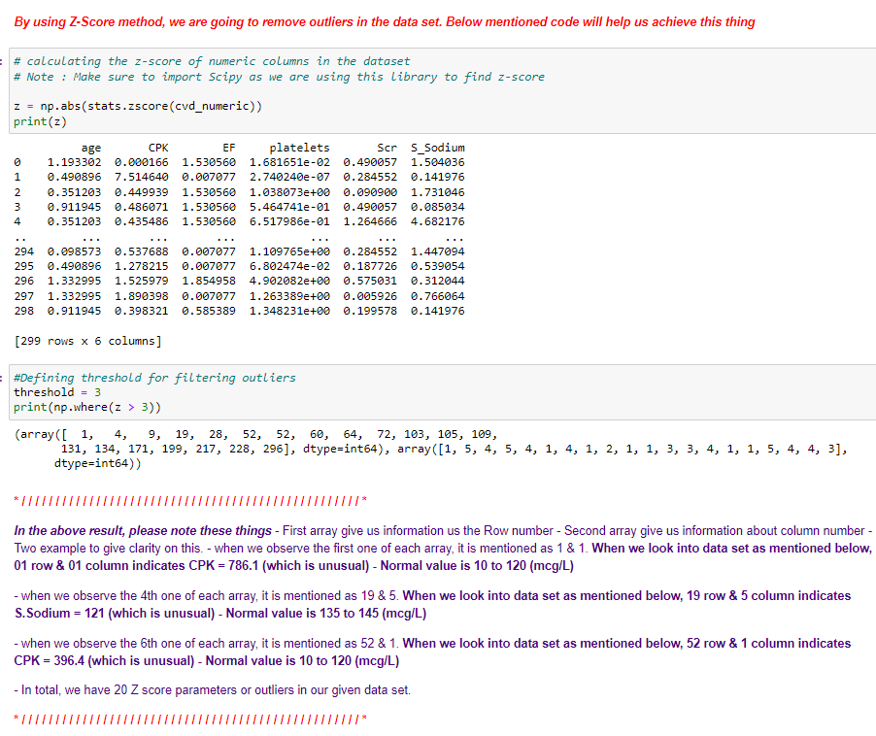
(EDA – Plots & Graphs) 2.12 –Finding Outliers & using Z-Score
15 – May 2023, Arun Ramamurthy
20 / 47

Slide 21
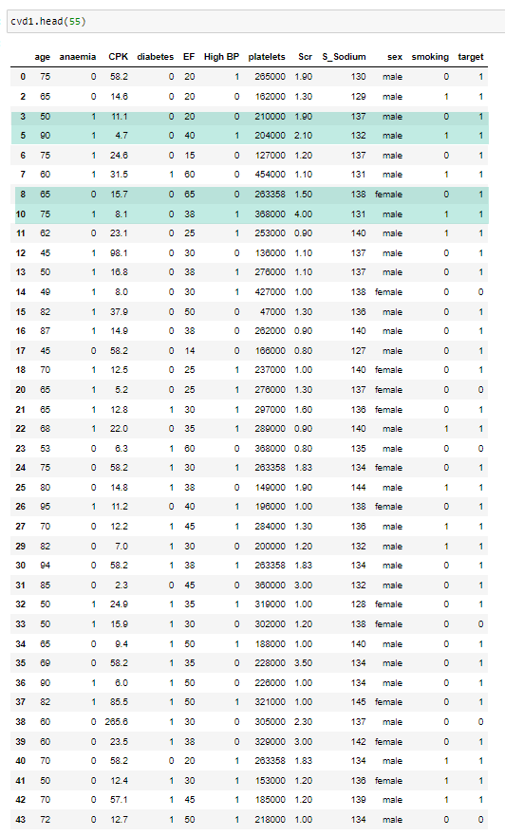
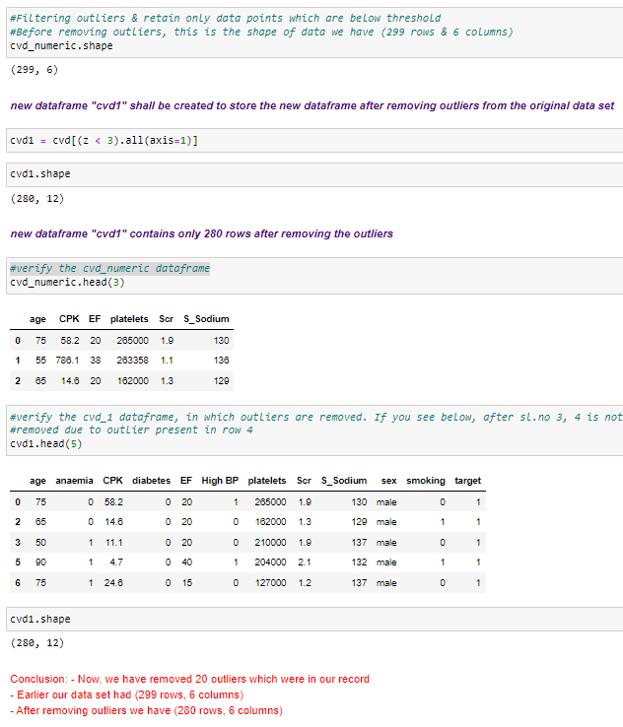
(EDA – Plots & Graphs) 2.13 –Finding Outliers & using Z-Score
The blue marked shows removed rows. Example, row 4 & row 9 are removed as highlighted
15 – May 2023, Arun Ramamurthy
21 / 47

Slide 22
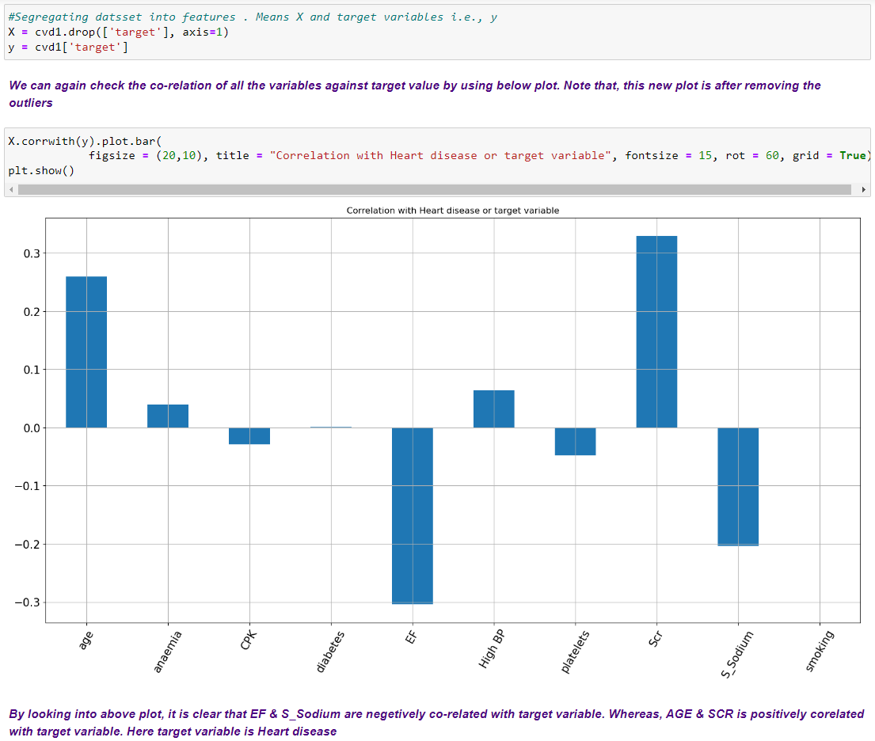
(EDA – Plots & Graphs) 2.14 – Checking co relation & heatmap after removing outliers
15 – May 2023, Arun Ramamurthy
22 / 47

Slide 23
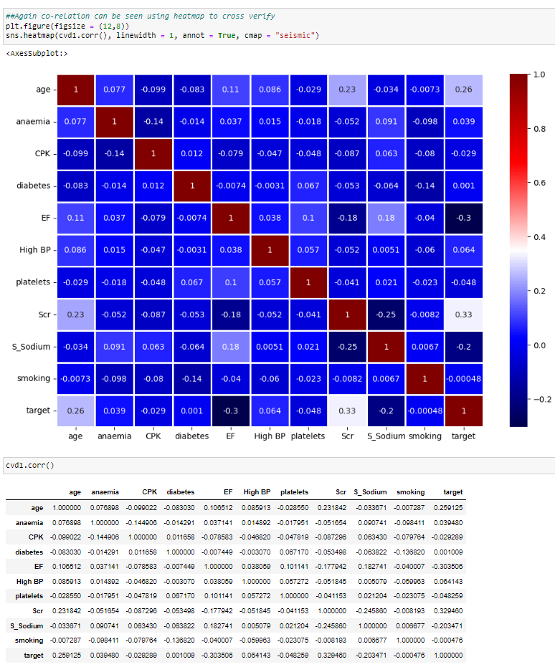
(EDA – Plots & Graphs) 2.15 – Checking co relation & heatmap after removing outliers
Conclusion from Heatmap (co-relation) statistics: (As mentioned earlier)
In our dataset, “Age” & “SCR” are positively co-related with target variable(as they are showing very light colour)
“EF” & “S_Sodium” are negatively co-related with target variable (as they are showing very dark colour)
The above plot is also showing the same thing
23 / 47

Slide 24
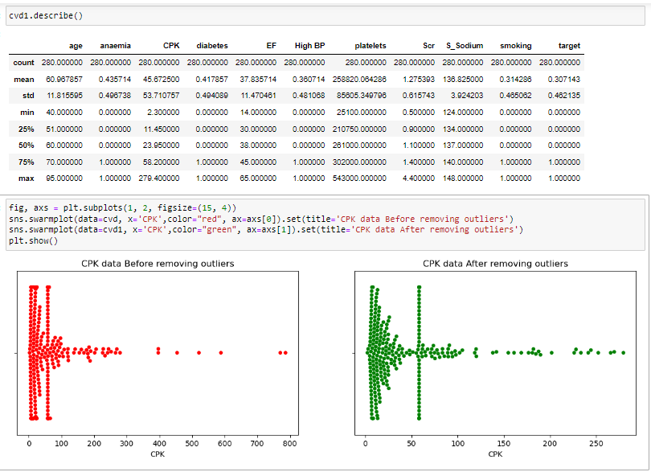
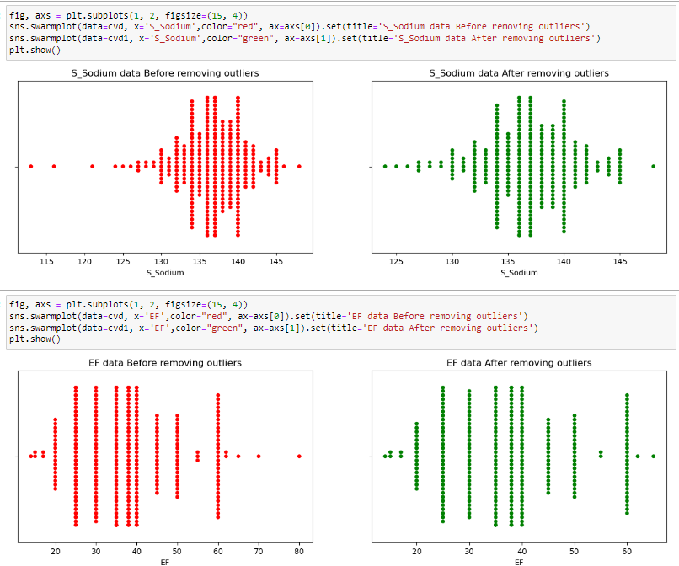
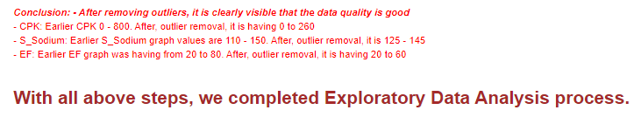
(EDA – Plots & Graphs) 2.16 – Check tendency of data after removing outliers + compare few input variables before vs after removing outliers
15 – May 2023, Arun Ramamurthy
24 / 47

Slide 25
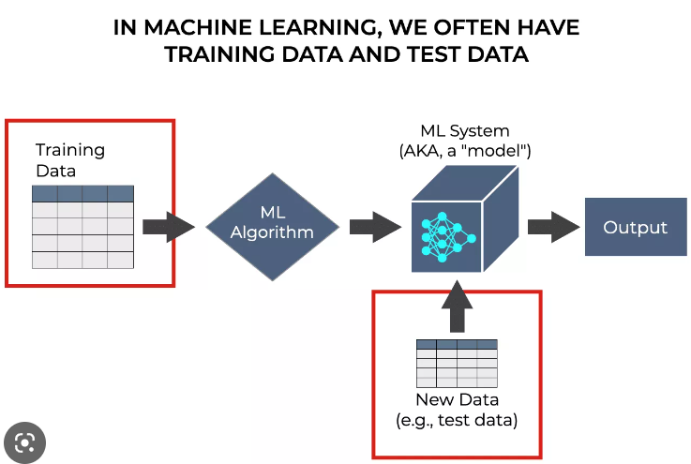
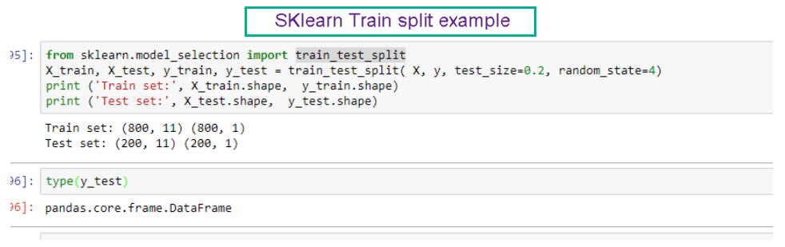
3. Split Data
3.1 - Training data & 3.2 - Test data
The train-test split is a technique for evaluating the performance of a machine learning algorithm.
The procedure involves:
Divide the data set into two subsets.
First subset is used to fit the model and is referred to as the training dataset.
Second subset is not used to train the model; instead, the input element of the dataset is provided to the model, then predictions are made and compared to the expected values.
The second dataset is referred to as the test dataset.
The objective is to estimate the performance of the machine learning model on test data.
In this model, we are going to split data on: Train data : 80 %, Test data: 20 %
We are going to use SKLearn library train_test_split to perform this task. (Example code is shown in this slide)
15 – May 2023, Arun Ramamurthy
25 / 47

Slide 26
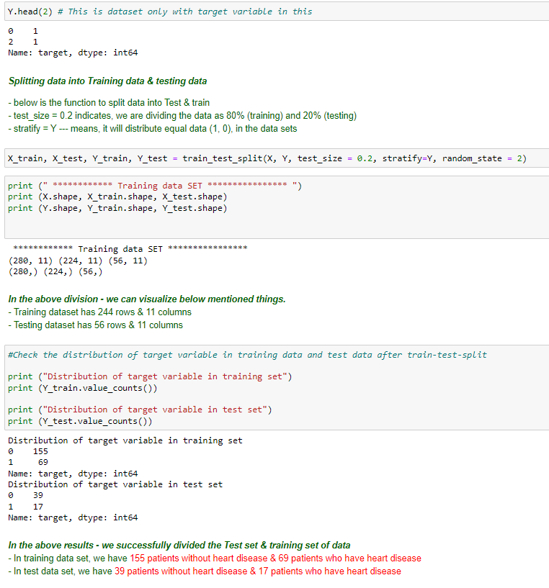
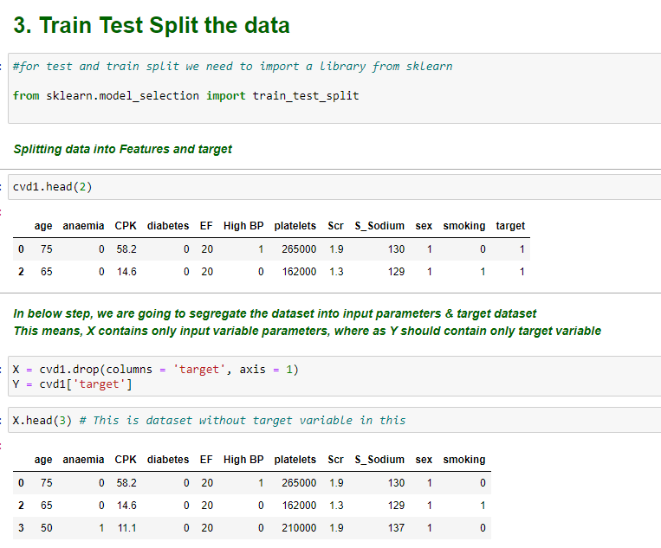
3.1 – Split & Training data
15 – May 2023, Arun Ramamurthy
26 / 47

Slide 27
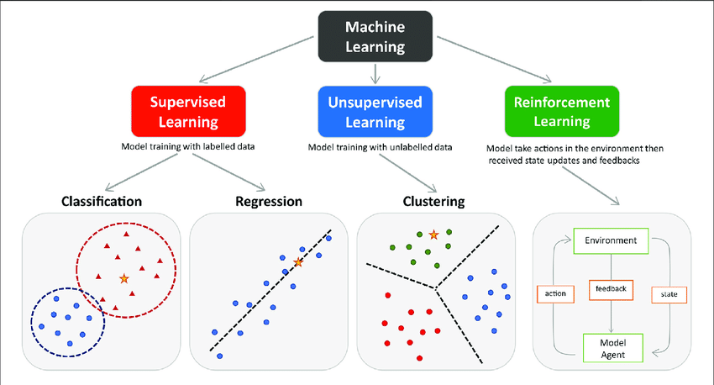
4.1 & 4.2 Supervised learning model and unsupervised learning model
Machine learning tasks in are classified into 3 types
Supervised learning
Unsupervised learning
Reinforcement learning
In our data set, we can classify this as Supervised learning because, we are going to use Historical / labelled data to produce the output.
Unsupervised learning refers to non-availability of “Historical or labelled data to produce the output” - Not applicable to this project
Reinforcement learning refers to “output depends on the current input and next input depends on the previous output”. In other words, machine learns from rewards or feedback – Not applicable to this project
Supervised learning is divided into 2 methods. Next slides explain further about this.
Classification
Regression
15 – May 2023, Arun Ramamurthy
27 / 47

Slide 28
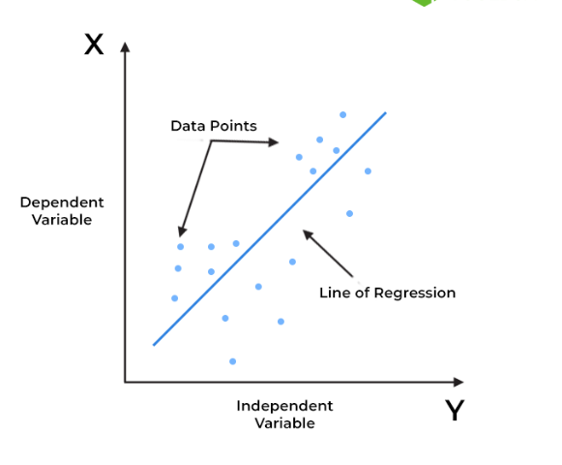
5. Regression
Example chart of Regression model
Regression is another division of supervised learning machine learning model. Few details about Regression model are given below for information only:
* Regression finds co-relations between dependent and independent variables. Therefore, regression algorithms help predict continuous variables such as House prices, market trends, weather patterns, oil and gas prices etc.
* The Regression algorithm’s task is finding the mapping function so we can map the input variable of “x” to the continuous output variable of “y”
* One of the important feature of regression model is the output is continuous.
* To conclude, in this project or ML model as our output is discrete (Heart disease present) we are not going to use Regression model. This information is given here only as a reference.
15 – May 2023, Arun Ramamurthy
28 / 47

Slide 29
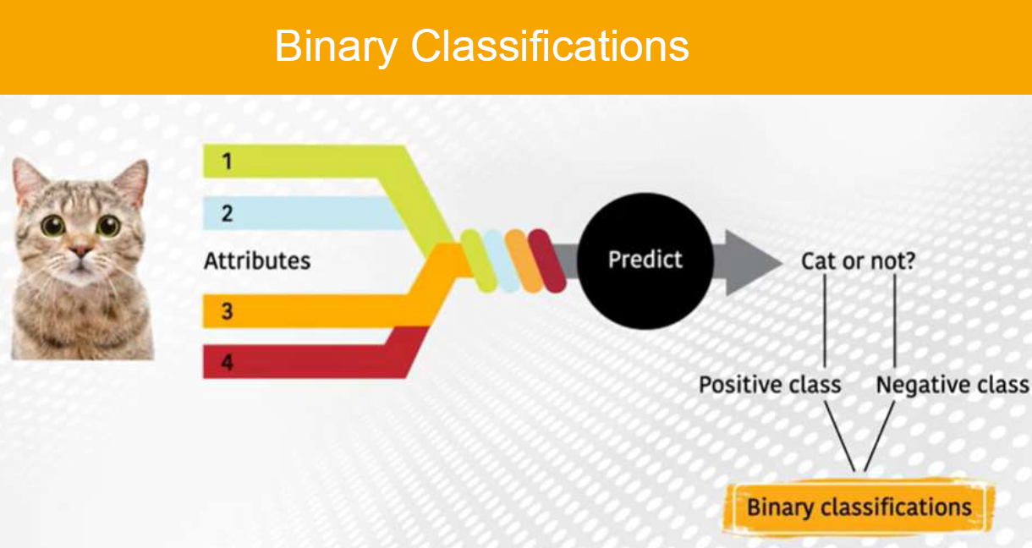
6. Classification
Example of Binary classification
There are 4 different types of classification tasks in machine learning.
Binary Classification
Multi-Class Classification
Multi-Label Classification
Imbalanced Classificcation
With reference to this ML model and with the given data set, as mentioned in earlier slides the outcome of the model is either of one condition
Heart disease present or No heart disease
Hence this model classification is treated as Binary classification.
Meaning of Binary classification:
“In machine learning, binary classification is a supervised learning algorithm that categorizes new observations into one of two classes. Where in, in this case the output is discrete”
15 – May 2023, Arun Ramamurthy
29 / 47

Slide 30
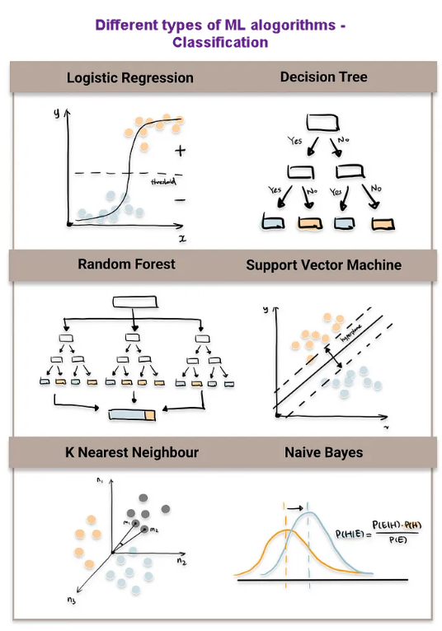
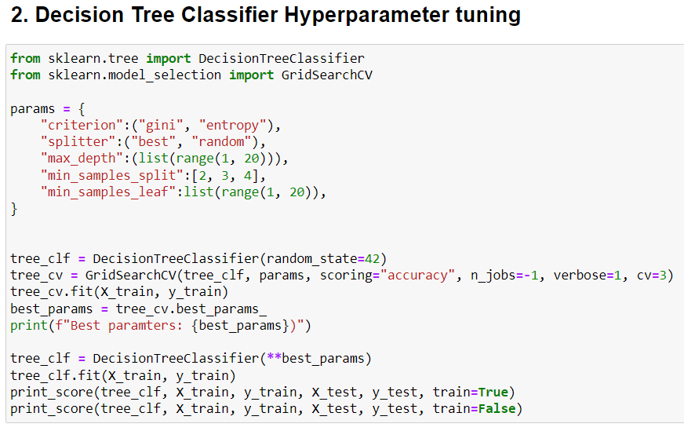
7. Trained Model
As Explained in Earlier section, with the given data set, we can conclude on following things and based on the classification, we can select the most suitable ML model we are going to use in this project with given data set.
With in the Classification, there are many machine learning techniques which we can use to predict the output “Heart disease”.
Figure enclosed in this slide show some of the ML models which can be used in our project to predict. Among these, any 2 models shall be used to predict the output.
In case we use Decision Tree classifier, example python code is shown in the figure in this slide
15 – May 2023, Arun Ramamurthy
30 / 47

Slide 31
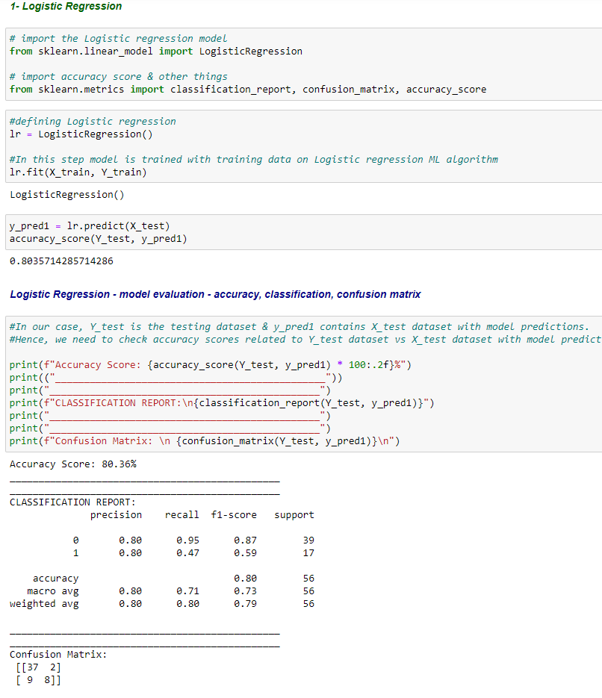
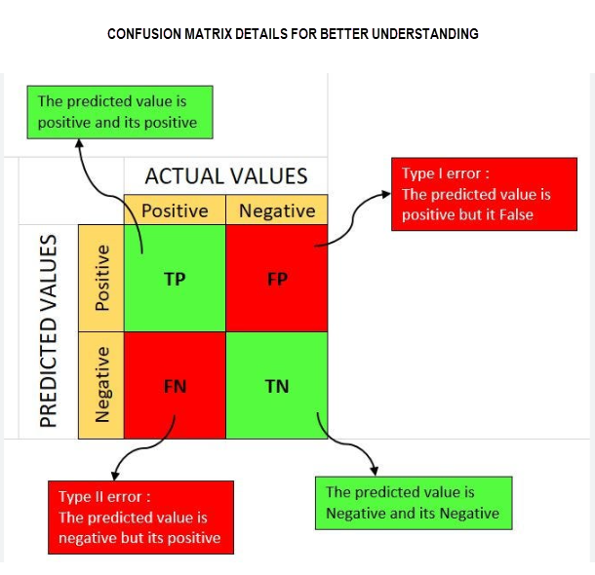
7.1 – Train the model with suitable machine learning algorithm. Here we are training our data with 7 various ML algorithm models.
7 Machine learning classifiers used in this project (ML algorithms) are listed below:
Logistic Regression
Decision tree
Random Forest
SVM (Support Vector Model)
KNN (K-nearest neighbors)
Naive Bayes
Gradient Boosting
Logistic Regression classifier– Facts
Logistic Regression is a supervised machine learning algorithm used for binary classification tasks.
It models the relationship between the features and the probability of the data point belonging to a particular class.
It uses the logistic function (also known as the sigmoid function) to transform the linear regression output into a probability value between 0 and 1.
The model is trained using a maximum likelihood estimation to find the optimal coefficients that maximize the likelihood of the observed data.
Logistic Regression is interpretable, computationally efficient, and can handle both numerical and categorical features, but assumes a linear relationship between features and the log-odds of the target variable.
31 / 47

Slide 32
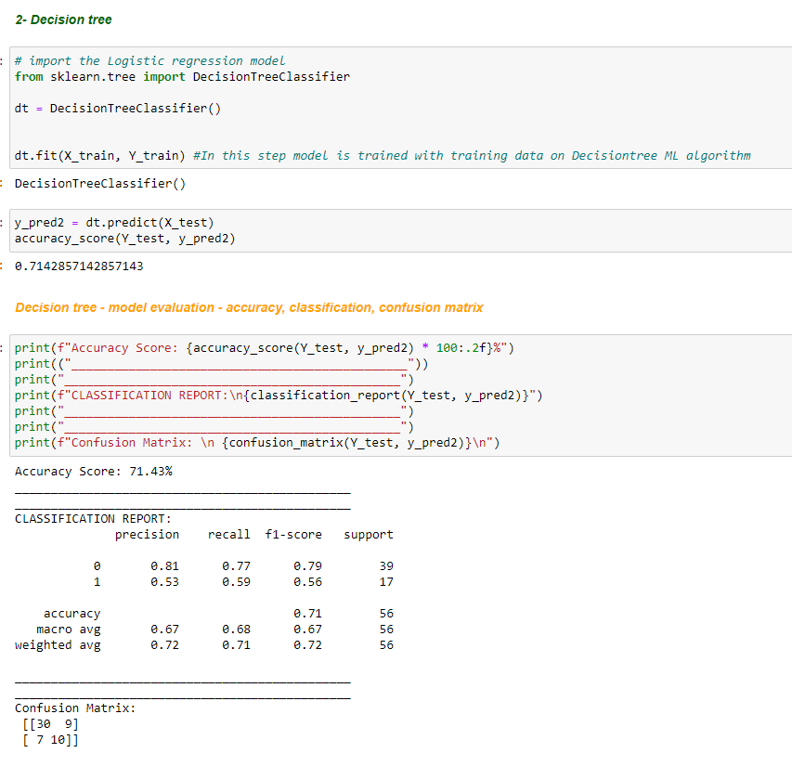
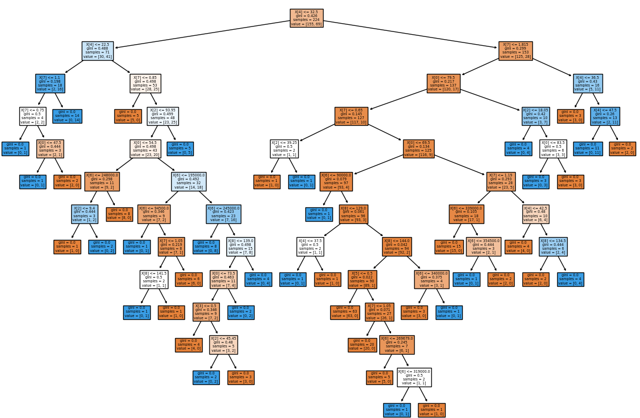
7.2 – Train the model with suitable machine learning algorithms (Model implementation + Accuracy scores + Classification report + Confusion matrix)
Decision Tree – pictorial representation
Decision tree Classifier – Facts
Decision Tree is a supervised machine learning algorithm used for classification and regression tasks
It builds a tree-like model of decisions and their possible consequences based on feature values
The tree structure consists of internal nodes representing features, branches representing decisions, and leaf nodes representing the predicted class or value.
Decision Tree splits data based on feature thresholds to create homogeneous subsets at each node
It is interpretable, can handle both categorical and numerical data, and is prone to overfitting on complex datasets.
32 / 47

Slide 33
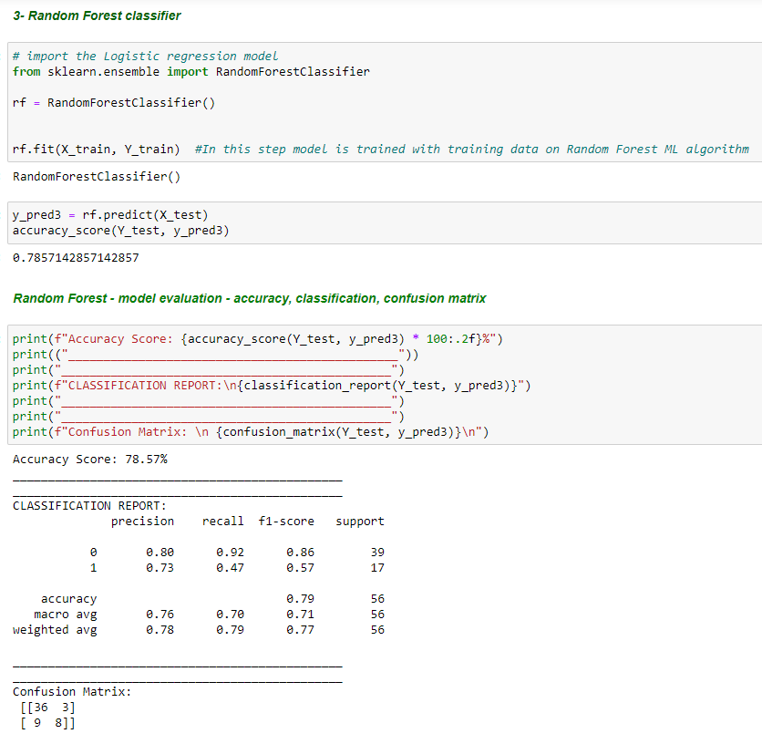
7.3 – Train the model with suitable machine learning algorithms (Model implementation + Accuracy scores + Classification report + Confusion matrix)
Random forest – Facts
Ensemble machine learning model
Constructed using multiple decision trees
Each tree is trained on a random subset of data
Combines predictions of individual trees for final classification
Handles high-dimensional data, avoids overfitting, and provides feature importance rankings
15 – May 2023, Arun Ramamurthy
33 / 47

Slide 34
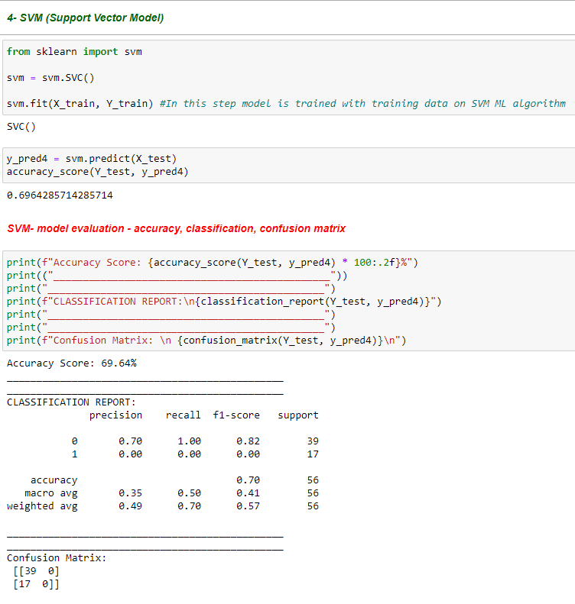
7.4 – Train the model with suitable machine learning algorithms (Model implementation + Accuracy scores + Classification report + Confusion matrix)
SVM classifier – Facts
Support Vector Machine (SVM) is a supervised machine learning algorithm for classification and regression
It creates a hyperplane that separates data points into different classes based on their features
SVM aims to maximize the margin, i.e., the distance between the hyperplane and the nearest data points of different classes
It can handle linear and non-linear classification problems by using different kernel functions
SVM is effective for high-dimensional data and can handle both binary and multi-class classification tasks.
15 – May 2023, Arun Ramamurthy
34 / 47

Slide 35

7.5 – Train the model with suitable machine learning algorithms (Model implementation + Accuracy scores + Classification report + Confusion matrix)
KNN classifier – Facts
K-Nearest Neighbors (KNN) is a supervised machine learning algorithm used for classification
It classifies a new data point by considering the majority class of its K nearest neighbors in the training dataset.
The value of K, the number of neighbors to consider, is a hyperparameter that needs to be specified.
KNN uses a distance metric (e.g., Euclidean distance) to determine the similarity between data points.
It is a non-parametric algorithm and can handle both numerical and categorical data but can be computationally expensive for large datasets.
15 – May 2023, Arun Ramamurthy
35 / 47

Slide 36

7.6 – Train the model with suitable machine learning algorithms (Model implementation + Accuracy scores + Classification report + Confusion matrix)
Naive Bayes classifier – Facts
Naive Bayes is a supervised machine learning algorithm based on Bayes' theorem and assumes independence between features.
It is commonly used for classification tasks and calculates the probability of a data point belonging to each class.
Naive Bayes computes the likelihood of each feature given the class and multiplies them to obtain the posterior probability.
It assumes that features are conditionally independent, simplifying the computation.
Naive Bayes is efficient, especially with high-dimensional data, but can be limited by the independence assumption and may not capture complex relationships.
15 – May 2023, Arun Ramamurthy
36 / 47

Slide 37

7.7 – Train the model with suitable machine learning algorithms (Model implementation + Accuracy scores + Classification report + Confusion matrix)
Gradient Boosting– Facts
Gradient Boosting Classifier is a machine learning algorithm that combines multiple weak learners to create a strong predictive model.
It is an ensemble method that builds the model in a sequential manner, where each subsequent model corrects the mistakes made by the previous models.
Gradient Boosting works by optimizing a loss function using gradient descent to minimize the errors between predicted and actual values.
It assigns weights to the weak learners based on their performance, allowing the model to focus on challenging instances.
Gradient Boosting is versatile, handles various types of data, and often provides high predictive accuracy, but can be computationally expensive and prone to overfitting if not properly tuned.
Gradient Boosting classifier : evaluation- accuracy, classification, confusion matrix
15 – May 2023, Arun Ramamurthy
37 / 47

Slide 38

7.8 – Train the model with suitable machine learning algorithms (Model implementation + Accuracy scores + Classification report + Confusion matrix)
This Barplot clearly shows:
- Logistic regression Machine Learning algorithm is giving us highest accuracy (80.36 %)
- 2nd highest accuracy is Random Forest ML algorithm (78.57 %)
15 – May 2023, Arun Ramamurthy
38 / 47

Slide 39

8. Test Model
Once the model is trained, we need to test the model with Test data. As explained in Sectin.3, we still have “Test Data set” and this will be used to test our model.
Until now, model is trained on “Training Data set”
In this step, the selected model will be tested on Training data and Test data set as well.
Picture mentioned in this slide shows an example python code from scikit-learn library. This shows an example python code of model being tested on Training data and Test data set.
Similar technique shall be used in this project with given data set.
This step has been completed in previous slides (7.1 to 7.6)
First, we train the model with training data
Then, we test the model with testing data
Further testing of the model with random data shall be executed in upcoming slides 8-1 to 8-3
15 – May 2023, Arun Ramamurthy
39 / 47

Slide 40

9. Evaluate Model Performance
Evaluation metrics quantify the performance of a machine learning model. It involves training a model and then comparing the predictions to expected values.
Once the model is trained, we need to test the model with Test data. As explained in Sectin.3, we still have “Test Data set” and this will be used to test our model.
Until now, model is trained on “Training Data set”
For classification models, the evaluation method includes Classification report which includes
Precision
Recall
F1-score
Support
Confusion matrix
Accuracy score
ROC Curve
One such example where, the model is tested and evaluated with above said evaluation methods are mentioned in this slide for reference purpose.
Similar technique shall be used in this project with given data set to predict the “Death event”
This step has been completed in previous slides (7.1 to 7.6)
After testing the various models, we are evaluating the model performance
In slide 7.8, we are also comparing which model performance is better. (highest accuracy)
15 – May 2023, Arun Ramamurthy
40 / 47

Slide 41

8.1 - Test the model: Test the model with random input data & check the result
15 – May 2023, Arun Ramamurthy
41 / 47

Slide 42

8.2 - Test the model: Test the model with random input data & check the result
In the above co-relation chart, we can clearly see the Positive & negative co-related factors with reference to target variable
As we can see, Positively co-related input factors are
“Age”
“SCR”
Negatively co-related input factors are
“EF”
“S_Sodium”
In next slide:
In first example, we modify (Increase) the AGE/SCR and check the result as these are positively co-related with “target” variable
In Second example, we modify(Decrease) the EF/S_Sodium and check the result s these are negetively co-related with “target” variable
42 / 47

Slide 43


8-3 Test the model: Example-1 & Example-2 with random variables in the input data (Check result in both the cases highlighted in RED)
43 / 47

Slide 44

10. Ensemble Learning (Optional)
Ensemble Learning is a general meta-approach to Machine Learning that seeks better predictive performance by combining the predictions from multiple models.
The predictions made by different models are taken as separate votes. Subsequently, the prediction made by most models is treated as the ultimate prediction.
To give an example, we might use Random forest and KNN ML algorithms for given data set. In the end, we are taking predictions of both of these models and do the Ensemble learning.
Types of Ensemble Modeling Techniques are:
Bagging
Boosting
Stacking
Blending
With in this healthcare project, this shall be done only if needed. Here it is mentioned to give brief introduction about this feature of Machine learning algorithm.
This step is not executed for the given data set / this project
15 – May 2023, Arun Ramamurthy
44 / 47

Slide 45

Conclusion – Summary of the Project - “RAM - Cardiac Risk Calculator”
We are at the last section of this presentation and here we are going to summarize the outcome of this project.
“RAM - Cardiac Risk Calculator” has been successfully developed with help of all the available resources as mentioned in the beginning of the presentation. (Software engineer, Python software and using all suitable Machine learning algorithm models)
We concluded which ML model is suitable for this data set and to achieve better accuracy with the given data set. Hence, given data is trained on the suitable or appropriate Machine learning algorithm.
At this point, the software development is completed for this project.
Now, Software development team will handover the developed software to Graphics team to design an attractive GUI which is essential for the App. This GUI will contain company logo and several field to enter the input data.
This Application - GUI (Mobile application or software) should allow patient to enter all the necessary parameters as explained in the beginning of this presentation.
All these inputs shall be taken into the software, which was prepared as explained in all the previous slides, and we can predict the chances of death due to Cardio-Vascular disease.
Based on this, patient can take remedial action to improve his health. For example, doing regular exercise to improve the health, consuming healthy food etc.
In this way, the company (Ram Health care) can release this App “RAM - Cardiac Risk Calculator” in the market and patients can use this application to know the chances of getting death(mortality) due to heart attack by entering few essential parameters related to their health.
This will increase the market cap for the company. Increasing brand visibility and recognition by appearing in app stores and search results.
Encouraging customer engagement and interaction with the company, which can lead to increased customer loyalty and advocacy.
Last but not the least, company can collect all the data of the users and customer behavior and preferences, which can be used to inform future marketing strategies.
15 – May 2023, Arun Ramamurthy
45 / 47

Slide 46


"A healthy heart is a fountain of gladness, making everything fresh and new." - Lydia M. Child
"Take care of your body. It's the only place you have to live." - Jim Rohn
"Your body hears everything your mind says. Stay positive." - Unknown
"शरीरमाद्यं खलु धर्मसाधनम्” - कालिदास , कुमारसम्भवम्
- "The body is the foremost means of achieving righteousness.“ – Kalidasa from Kumarasabhavam
15 – May 2023, Arun Ramamurthy
46 / 47

